Slide 1
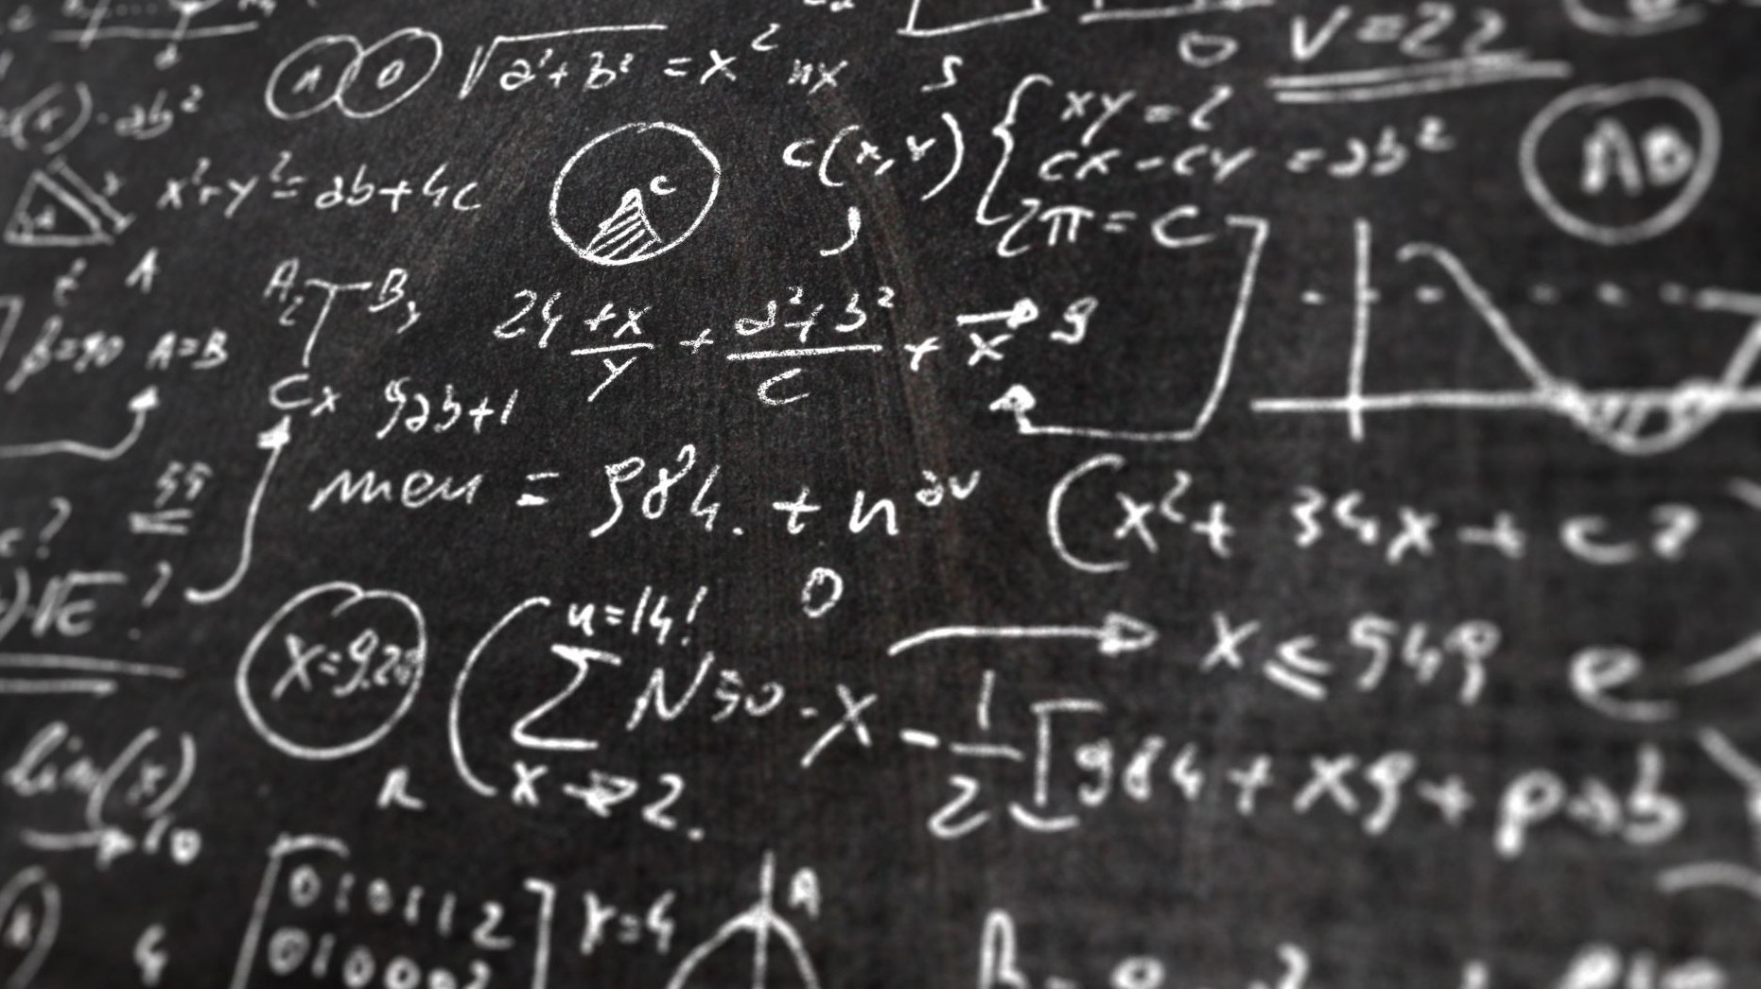
TransArt: A Multimodal Application for Vernacular
Language Translation and Image Synthesis
ARULSELVI.M

Slide 2

Project Introduction
Trans Art is a versatile application combining AI-driven language translation and image generation.
The app is designed to seamlessly transcribe, translate, and visualize content from vernacular languages, specifically Tamil, into English, while offering creative text generation and image synthesis capabilities.
Jamuna V

Slide 3
Project flow
Translate Tamil text to English
Generate an image from the translated text
Generate creative text from the translated text
Jamuna V

Slide 4
Python Libraries
Os -Interacts with the operating system.
Requests- Sends HTTP requests.
Transformers- Handles NLP models and tokenization.
PIL- Works with images.
io- Manages in-memory file streams.
Gradio- Creates interactive web interfaces.
Torch- Builds and trains deep learning models.
Jamuna V

Slide 5
API key – Hugging face
model:
TAMIL TO ENGLISH
text generation
Jamuna V

Slide 6
API key – Hugging face
model:
Tamil to English - “Helsinki-NLP/opus-mt-mul-en”
text generation – “EleutherAI/gpt-neo-1.3B”
Jamuna V

Slide 7
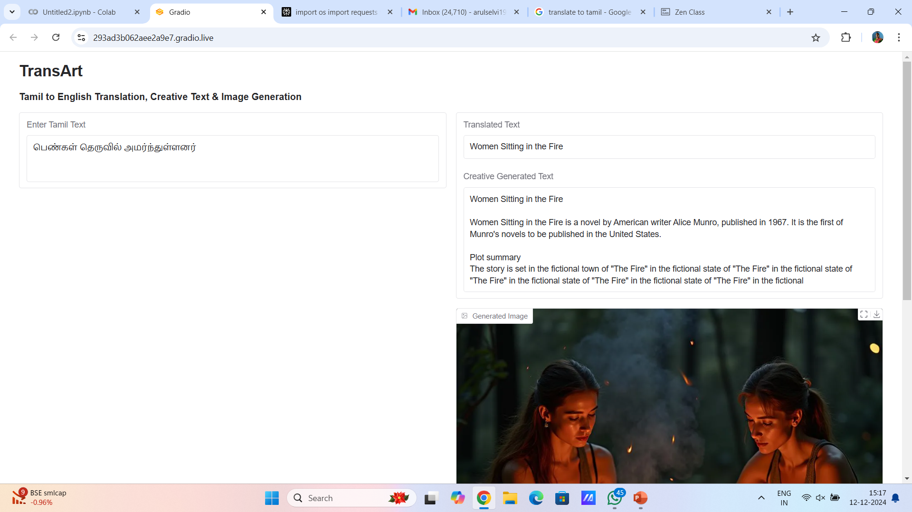
Gradio

Slide 8

ARULSELVI.M

